Slide 1


SAP BTP Training
Cloud Foundry Training

Slide 2

DISCLAIMER
The training content and delivery of this presentation is confidential, and cannot be recorded, or copied and distributed to any third party, without the written consent of Anubhav Trainings

Slide 3

LEARNING OBJECTIVES
SAP BTP CAPM Development
Create Fiori App using destination
Introduction to CI/CD
Create CI Service
Build and deploy to CF – automate
Create Cloud TMS Service
Create CD pipeline

Slide 4
Title
SAP Fiori Launchpad
Html repo.
SAP Fiori App
destination
SAP Fiori App
SAP Fiori App
BAS
SAP Fiori App
SAP Fiori App
Destination
S/4HANA
SCC
www.anubhavtrainings.com

Slide 5
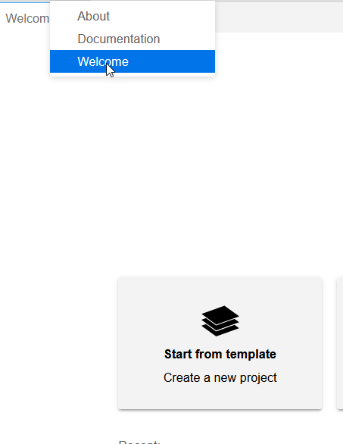
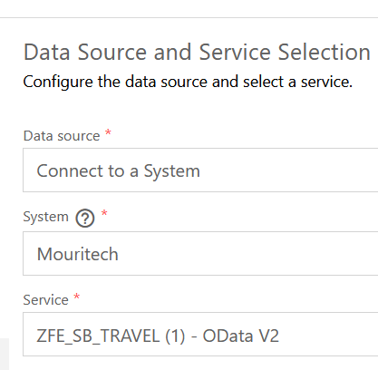
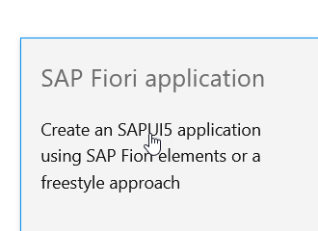
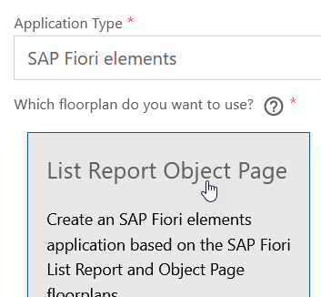
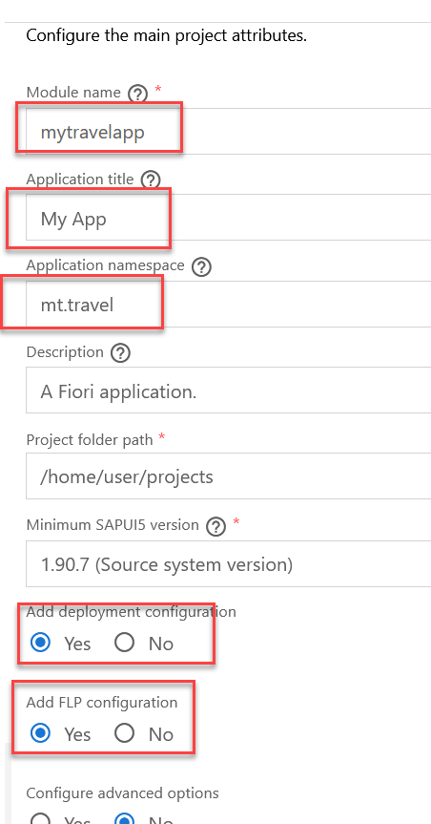
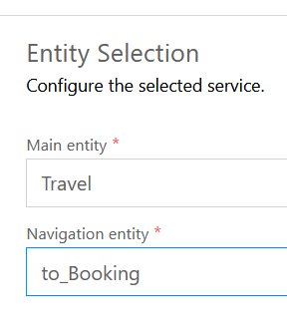
Title
www.anubhavtrainings.com

Slide 6
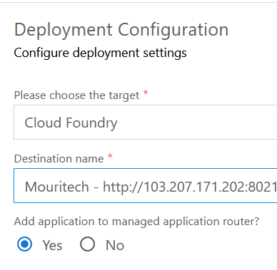
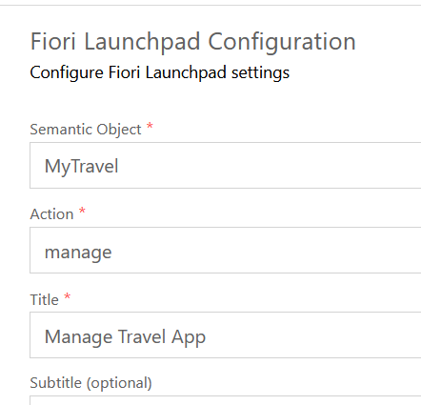
Title
www.anubhavtrainings.com

Slide 7
Title
www.anubhavtrainings.com

Slide 8

Summarize
LET’S SUMMARISE!

Slide 9

Summarize
End of Day 15

Slide 11


We’re committed to empower you to be
#FutureReady
through powerful training solutions.
We build the workforce of the future.
250+
Corporate Clients
30,000+
Learners Trained
25000+
Learners Placed
FREE WEBINARS
Sign up for free webinars with industry experts every fortnight!
Enroll Now!
Contact us today!
https://anubhavtrainings.com

